Slide 1
Capital Project & space request process Spring, 2022

Slide 2
Drawbacks: Current Project request process
Rolling process that makes it difficult for leadership to prioritize decisions
Not integrated with Academic, Strategic or Financial Planning processes
Funding guidelines are unclear
Where and with whom does the process begin?
What are the steps in the process?

Slide 3
Project & Space Request Process
Client initiates a capital project or significant space request by contacting Space, Capital Planning & Real Estate (SCPRE)
SCPRE consults with the client to develop project proposal
Customer submits a Project Request form
Here a rejection might be because there is no funding source provided
The Project Request form is returned to the client for revisions
No
Is the Project Request Form complete?
Yes
PDC/SCPRE analyze the Project Request form and provides feedback to client
Here the rejection might be rejected because the project itself is not an institutional priority
The Chancellor reviews the Project Request form, presentations of goals and intent, and the SCPRE/PDC analysis, pros and cons.
If rejected the Project Request form is returned to the Client with comments & suggestions
No
Approved or Rejected
Yes
Minor Capital Projects
$35K - $1MM
1. Client submits Project Request form to initiate the project
2. If required, approval of a study site is obtained.
3. Approval of design, budget and funding agreement are required to start construction. CEQA is required if the project is constructed on a previously unused site.
Small Capital Projects - $1MM to $10MM
1. The Office of SCPRE will assist with the development of a project scope document and an initial ROM budget. This is submitted with a draft funding plan on a project request form to initiate the project.
2. The Campus Architect will work with the client to develop a proposed site. Approval of the study site is sought with the submittal of a Project Request form.
3. Planning, Design and Construction manages the CEQA evaluation, design and creation of a final budget. A Project Request Form is submitted with a final project proposal, budget and funding source for approval before construction may be started.
Mid-Sized Capital Projects - $10MM to $70MM
1.The Office of SCPRE and the University Architect will assist the client in developing a Project Scope document, ROM budget and funding plan. These documents are used to secure approval to launch the project and initiate the Project Certification process.
2.Planning, Design and Construction is responsible for completing the necessary steps to obtain approval of the Project Certification from the Office of the President. See slides 9-11 for more detailed description of the steps involved in obtaining approval for and completing a mid-sized capital project.
3. Completion of Mid-Sized Capital Project is a 2- to 3-year process
Major Capital Projects > $70MM:
A major capital project must evolve from the Strategic Planning process and be already represented on the Capital Financial Plan.
Leadership & stakeholder discussions are initiated to guide and develop the project
Participation in the Regental approval process is managed through the Office of SCPRE.
The design, CEQA and budget development are completed under the auspices of Planning, Design and Construction.
Completion of a Major Capital Project is a 3- to 4-year process.
Space Requests
SCPRE
will finalize the space assignment
Notify the stakeholder(s) & space inventory staff of the assignment.

Slide 4
Not Included in the New Space and Project request Process
Space requests for one or two people. These should still be submitted directly to Maggie Saunders and will be resolved through the relevant VC, Dean or Department Chair.
Deferred maintenance projects managed by Facilities Operations and funded by AB94 funding.
Simple relocation projects (with no facilities component) facilitated by Moving and Events Services.
Research projects with separate grant funding and no facilities project

Slide 5
New Project Request Process: TIMING
Project Request forms to initiate Minor Capital Projects (>$35,000 and <$1MM) may be submitted four times a year in February, May, August and November. Faculty lab retrofit projects for new faculty are included in this category
Project Request Forms to initiate Campus Capital Projects (>$1MM-<$10MM), Mid-sized Capital Projects (>$10MM-<$70MM) and Major Capital Projects (over $70MM) may be submitted twice a year in February and August.
Project Request Forms to make a space request for more than three people may be submitted Quarterly in February, May, August and November.
Project Request Forms seeking to advance a project to the next stage for an already approved project may be submitted Quarterly in February, May, August and November.
December
January
February
March
April
May
June
July
September
October
August
November
Budget Requests
due – 4/15
Faculty new hire arrival

Slide 6
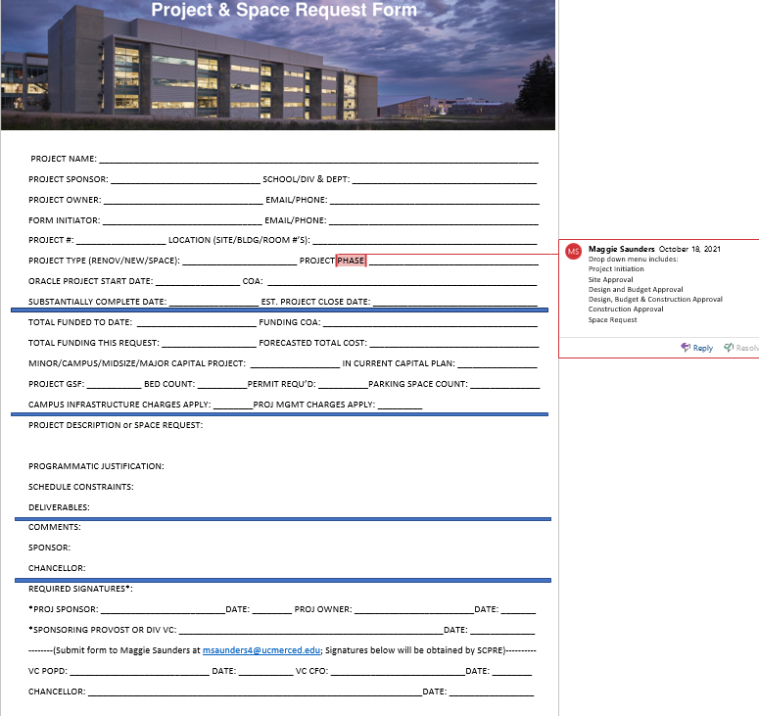
Project & Space Request Form

Slide 7
Project Development and Approval Phases
Minor Capital, Relocation & Faculty Lab Retrofit Projects (>$35,000 and <$1,000,000)
Submit project or space request form to SCPRE
Identify site development requirements and constraints, complete initial environmental evaluation
Design & Construction Drawings, Code Review & Permitting. Obtain cost estimate. Complete CEQA evaluation
Confirm Funding Source. Complete the Project
SCPRE reviews the scope, site & funding source
Based on design, cost estimate & schedule and pursuant to CEQA seek construction approval from:
VC, Dean or Provost
Chancellor
Update the space management system
Occupy the space
Seek Project Study Site Approval from:
CACLU (if required)
Campus Architect
Chancellor
Many projects will occur at existing sites in existing buildings. When a new site is necessary this step must be followed.
Many of the 2020 backfill projects completed this past year are examples of Minor Capital Projects – e.g. Relocating the Advising Center.

Slide 8
Project Development and Approval Phases
Campus Small Capital Projects (>$1,000,000 and <$10,000,000) – for example, the MVPGR Pavilion Project
Submit Project or Space Request Form to SCPRE
Identify site development requirements and constraints, complete initial environmental evaluation
SD/DD drawing development, code review, detailed schedule, cost estimate and CEQA evaluation.
Construction drawings, Permitting, detailed schedule and logistics plan. Final costs are determined.
Sign funding agreement. Complete construction and furniture installation. Obtain certificate of occupancy.
SCPRE clarifies project scope, ROM budget and funding strategy, logistical constraints, schedule targets.
Project Scope document is used to seek approval to launch the project from:
Project Sponsor
VC POPD
Seek Project Study Site Approval from:
CACLU
Campus Architect
Chancellor
Predicated on design, cost estimate & schedule and pursuant to CEQA findings, seek approval to generate construction drawings and logistics plan.
Requires approval of:
Exec Director PD&C
Provost, VC or School Dean (sponsor)
Chancellor
Seek Construction approval from:
Exec Director, PD&C
VC & CFO
Chancellor
Occupy the facility
Update the space management system
The MVPGR Pavilion and the Experimental Smart Farm projects are examples of Campus Small Capital Projects

Slide 9
Mid-Sized Capital Projects: >$10,000,000 and >$70,000,000 At UC Merced, there are a series of steps required for review and approval of mid-sized capital projects: ($10MM-$70MM) beyond the requirements outlined in the UC delegated process (DA2629):
PROJECT DEVELOPMENT AND APPROVAL PHASES
Exec Director, SCPRE & Director of Physical and Environmental Planning – Approval of planning parameters and assumptions. Evaluation of whether the project meets the Certification Checklist requirements.
VC POPD - Approval of project scope, tentative site and timeline
CFO - Approval of Funding Plan for the Project
Chancellor - Approval of project goals, scope, site, timeline and funding source
If you are considering a Mid-Sized Capital Project, it is critical that you begin discussing your goals and objectives for the project with your Division or School leadership and Maggie Saunders, Executive Director of Space, Capital Planning & Real Estate at least two to three years in advance of the need for the facility.

Slide 10
Project Development and Approval Phases
Mid-Sized Capital Projects: >$10,000,000 and >$70,000,000 (continued)
All or some part of a mid-sized capital project may fall under the Certification Checklist process described in the Facilities Guide and authorized under the Delegation of Authority (DA 2629). The Certification Checklist and attachments must demonstrate that the stated planning principles, design objectives, specific design guidance, and the campus design review and approval process have or will be met by the project.
The Certification Checklist is used to document a project’s eligibility for delegated budget approvals (DA 2629) and design approvals following action pursuant to the California Environmental Quality Act. These projects while they do not need to follow the Regental approval process, they must follow the certification process.
Projects in this category must demonstrate:
Cost between $10MM and $70MM
Capital Financial Plan consistency
Physical Design Framework Consistency
LRDP consistency
Compliance with CEQA and University/Regental Policies
Financial Feasibility
Adherence to the UC Merced Strategic Plan
A net zero operational pro-forma
No other special circumstances requiring Regental review.
A Certification Checklist (RD2.8) must be submitted to UCOP Capital Asset Strategies to confirm that the project is eligible to proceed with budget and design approval(s) pursuant to DA2629.
Projects funded wholly or in part by State funds are not eligible for budget approval through the Certification Checklist (RD2.8); hence, this process is more often used for non-stated funded projects.
However, the design of projects using State funds with a project budget no more than $70 million may be approved under DA2629.

Slide 11
Mid-Sized Capital Projects: >$10,000,000 and <$70,000,000 In addition, to the requirements of the UC Office of the President, the UC Merced campus has the following requirements for approval of mid-sized capital projects in the range of $10MM to $70MM dollars.
PROJECT DEVELOPMENT AND APPROVAL PHASES
Submit Project Request form to SCPRE
Identify site development requirements and constraints, complete initial environmental evaluation
SD/DD drawing development, code review, detailed schedule and cost estimate. CEQA evaluation.
Construction drawings, permitting, detailed schedule and logistics plan. Final costs are determined.
Sign funding agreement, complete construction and furniture installation. Obtain certificate occupancy.
Project owner consults with Exec Director of SCPRE and/or Director of Physical and Environmental Planning regarding the scope and intent of the project
A Certification Checklist (RD2.8) must be submitted to UCOP Capital Asset Strategies to confirm that the project is eligible to proceed with budget and design approval(s) pursuant to DA2629.
https://www.ucop.edu/construction-services/facilities-manual/volume-2/vol-2-chapter-7.html#7-5
SCPRE clarifies project scope, ROM budget and funding strategy, logistical constraints, schedule targets. Project Scope document is used to seek approval to launch the project from:
Project Sponsor
VC POPD
Seek Project Study site approval from:
CACLU (if appropriate)
Campus Architect
Chancellor
Based on design drawings, cost estimate, schedule, the project owner seeks campus approval of design pursuant to CEQA and permission to seek approval of the Certification Checklist from UCOP.
Seek construction approval from:
Executive Director, PD&C
VC & CFO
Chancellor
Occupy the facility.
Update the space management database.
Update the Capital Projects database, UCOP.

Slide 12
Project Development and Approval Phases
Major Capital Projects in excess of $70,000,000
Should evolve from the Strategic Planning process or as an outcome of a space utilization analysis,
Must be a part of the current Capital Financial Plan or be at the direction of the Capital Planning Team (CPT) or Senior Advisory Council (SAC), and
Must follow the Regental Process as outlined by the Office of the President in the Facilities Guide.
All major capital projects are facilitated through the Space, Capital Planning & Real Estate (SCPRE) and Planning, Design & Construction Offices (PD&C)

Slide 13
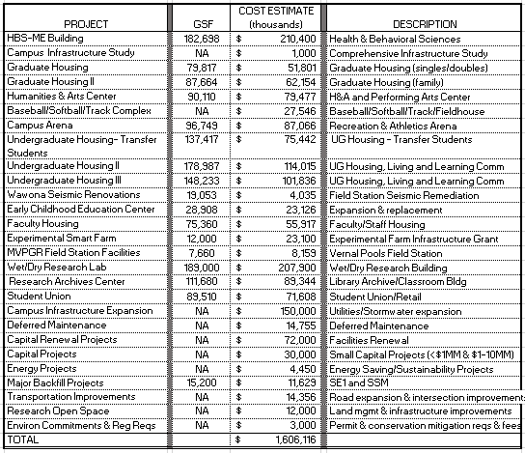
2021-2027 CAPITAL FINANCIAL PLAN
An Engineering Building may be added to the 2022-2028 CFP

Slide 14
Project Development and Approval Phases
Major Capital Projects in excess of $70,000,000
Following an RFP phase Planning, Design and Construction contracts with a team to develop the SD and DD drawings and to initiate the CEQA evaluation. Schematic Design/Design Development, Budget, Schedule, CEQA evaluation are completed
The Executive Director of SCPRE gathers additional information, places the project on the CFP and develops a stakeholder group to refine the space program.
Approval is sought through the Finance and Capital Strategies Committee of the Regents for Project Design, Site and Budget approval pursuant to CEQA.
Adoption of CEQA findings.
Major capital projects evolve through the Strategic Planning process or as a result of a space utilization study. A project request form may be initiated at the request of the SAC, Capital Planning Team or the Chancellor
Project Request form is submitted to SCPRE outlining the need, concept and requirements for the facility
The Project concept is approved by the Project Steering Committee, Project Sponsor and the Chancellor. UCM submits the project as an Item to the Finance and Capital Strategies Committee of the Board of Regent’s for P-Funds
Working drawings are completed, and permits are obtained.
Exec Director of SCSRE works with the Campus Architect to develop site options for the project. These are submitted via a Project Request form to CACLU and the Chancellor for approval.
An Item is created to seek Design/Budget and Site approval pursuant to CEQA. The Chancellor approves the Item prior to seeking approval from the Regent’s
The Offices of Space, Capital Planning and Real Estate and Physical and Environmental Planning coordinates the planning of major capital projects.
Planning, Design & Construction is responsible for the implementation of major capital projects.

Slide 15
Projects Under $35K & Space Requests (1-2 persons)
For projects under $35K users should submit a work order to Facilities Management including the details of the project, the building name and room number(s). A funding source must be identified, and an executive sponsor must sign the request. The relevant Building Manager or another member of Facilities Management will contact you to discuss the project.
For space requests for 1-2 persons, please contact Maggie Saunders (msaunders4@ucmerced.edu) directly and she will work with your Department Chair, Dean, or VC to determine an appropriate space assignment(s).

Slide 16
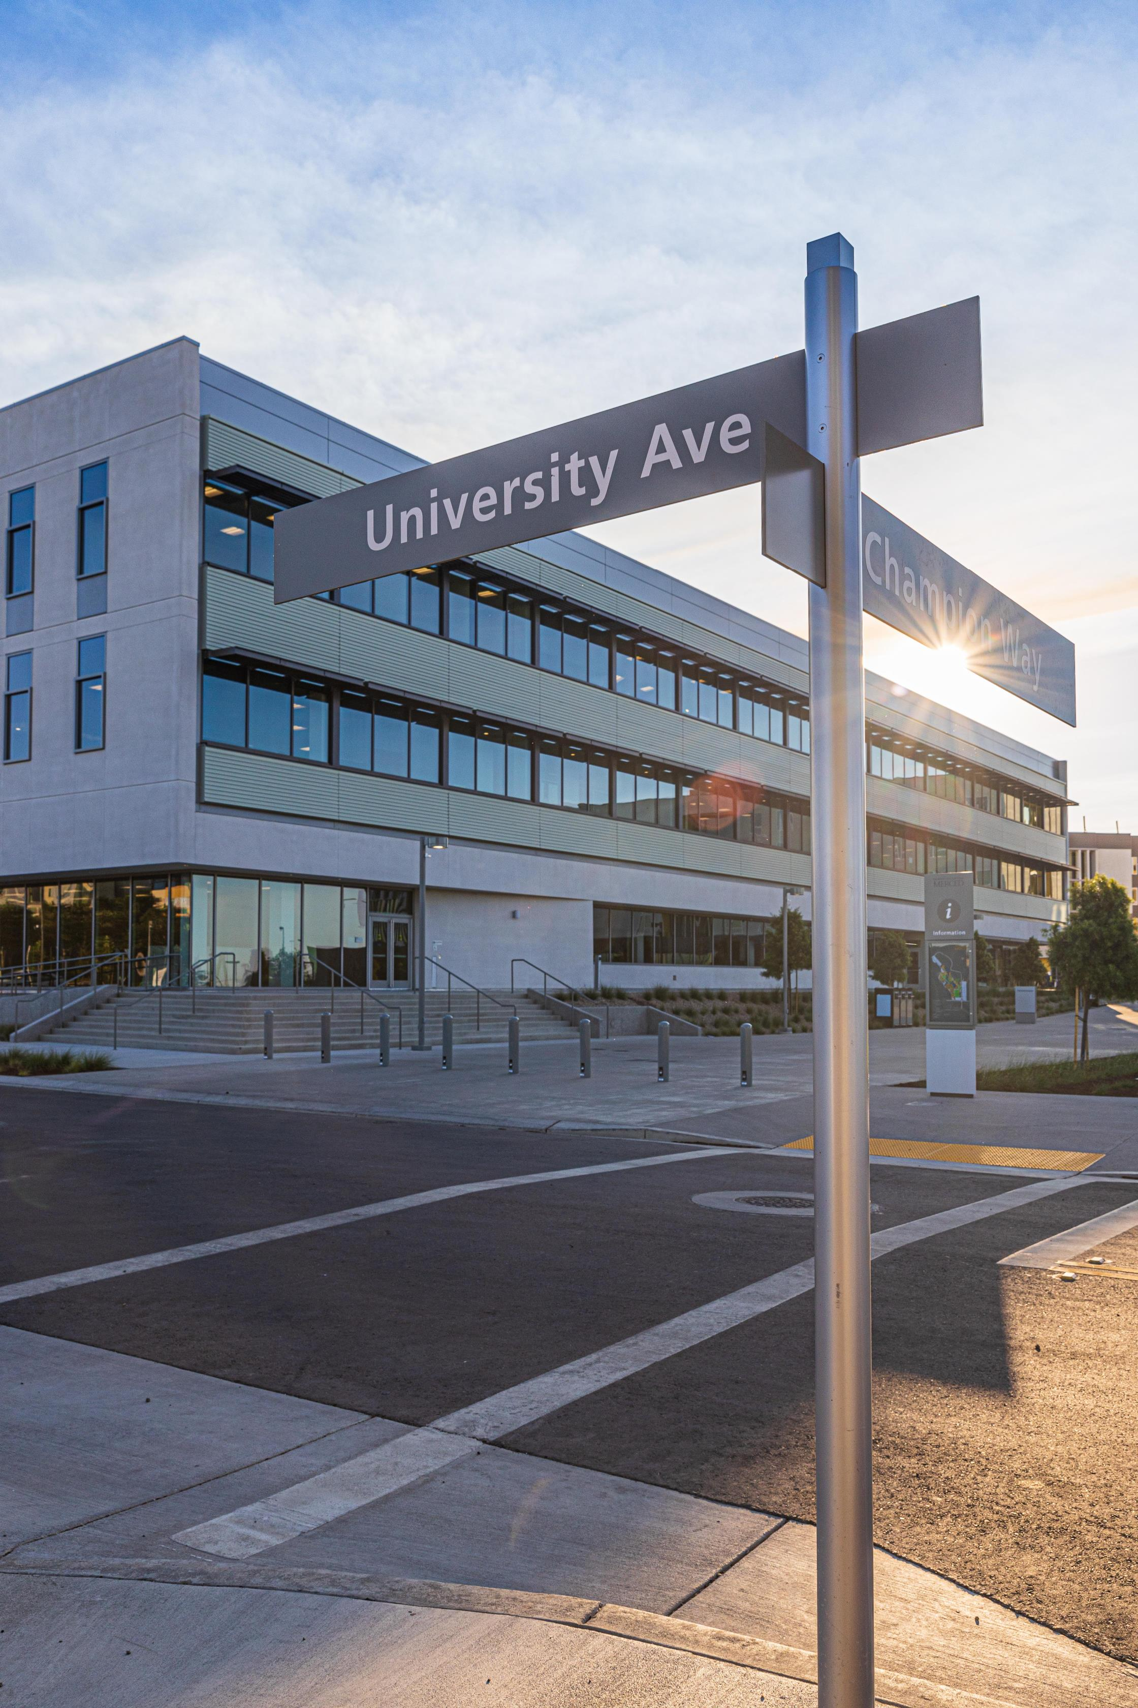
IMPACT of NEW PROJECT REQUEST PROCESS
Planning ahead will be rewarded.
Users are advised to leverage the strategic planning and budget processes to identify project requirements and secure the necessary funding in advance of requesting a project

